Slide 1
Back-End, Front-End, Project Management | March 20
NO QA RESOURCES?
YOU CAN STILL DELIVER A QUALITY SITE
Presented by: Sadia Rodriguez,
Senior Quality Assurance Analyst, Bounteous

Slide 2


*Edit This* Bio Slide
Sadia Rodriguez
Bounteous – Senior Quality Assurance Analyst
FIRST Lego League coach and judge, Girl Scout STEM coordinator+, Hour of Code volunteer, Cat Pawsitive trainer, mom of twin teens, master procrastinator, former mainframe programmer
sadia.rodriguez@bounteous.com
@BaqaSadia

Slide 3
What to Expect this Hour
An overview of Quality Assurance (QA)
Ideas for how to get QA done without a designated QA person
An introduction to test planning and execution for lean teams

Slide 4
WHAT IS QUALITY?

Slide 5

*Edit This* Slide with Photo (<1/3 split).
“I know it when I see it…”
- Supreme Court Justice Potter Stewart

Slide 6
Software Quality
Conformance to requirements
Data integrity
Data accuracy
Usability
Reliability
Consistency
Learnability
Maintainability
Performance
Capacity
Time sensitivity
Security
Fault tolerance
User error
Component failure
Conformance to standards
Aesthetic appeal
Uptime
Responsiveness
Scalability
Extensibility
And things that matter to you

Slide 7
*Edit This* Content Slide with Title and Body Copy - You can duplicate this slide.
Quality Assurance vs Testing
Quality applies to all parts of a project or site
Testing is a major part of software quality assurance, but not the only part
Code
Process
Communication
Documentation

Slide 8
WHO IS RESPONSIBLE FOR QUALITY?

Slide 9
The person with “Quality” in their title is responsible for Quality.
Duh.

Slide 10

The person with “Quality” in their title is responsible for Quality.
Duh.

Slide 11

*Edit This* Slide with Photo (1/2 split).
Everyone is responsible for quality

Slide 12
*Edit This* Slide with Photo (1/2 split).
Everyone is responsible for quality…
but ownership is necessary.

Slide 13

Distribute QA tasks among team members

Slide 14
Quality Assurance Tasks
Test planning (sample test plan)
Test execution
Bug documentation and reporting
Bug and improvement prioritization
Test data creation
Writing unit tests
Test environment/framework setup
Test automation
Automated test maintenance
Automated test output review
Process evaluation and improvement
Code review

Slide 15
There is no “one size fits all” solution.
Think early and often about quality goals.
Plan for quality.
Carry out your plan.
Expand (or contract) your QA plan as you see the need.
Account for the time and preparation ensuring quality takes.

Slide 16
WHY TEST?

Slide 17
*Edit This* Content Slide with Title and Body Copy - You can duplicate this slide.
Why Test Software?
Verify that what you build is of acceptable quality
Everyone has a different idea of what “quality” means
Define quality, as a team, for your site, functionality, or project. Plan your testing with this definition in mind.

Slide 18
The goal of testing is to verify that your site is of acceptable quality.

Slide 19
TEST PLANNING

Slide 20
There is no “one size fits all” solution.
Think early and often about quality goals.
Plan for quality.
Carry out your plan.
Expand (or contract) your QA plan as you see the need.
Account for the time and preparation ensuring quality takes.

Slide 21
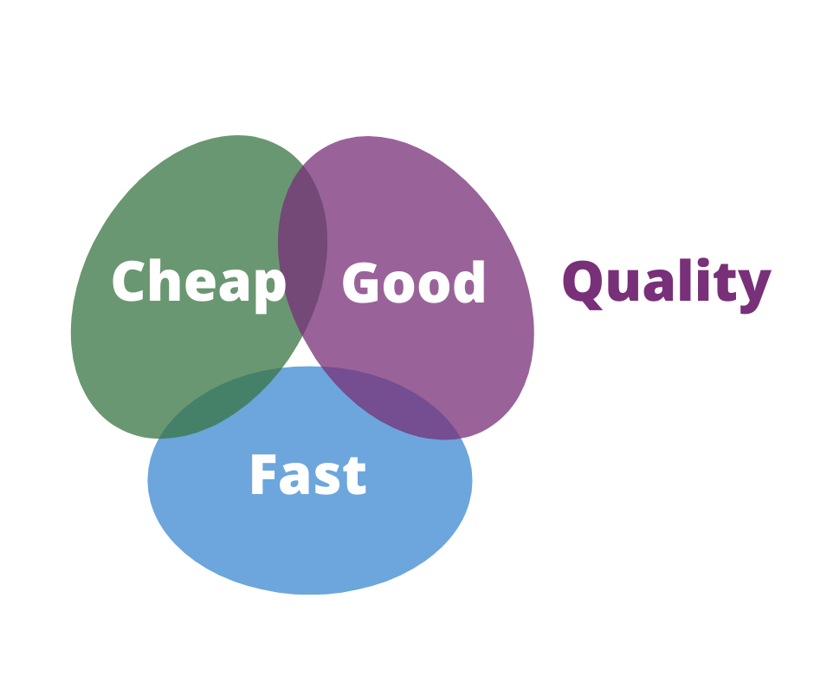
Remember the Project Triangle

Slide 22
Be realistic about what you can test and how long it will take

Slide 23
Be Strategic
Know what the team could be testing, then decide what you will test
Time box your testing

Slide 24

Baseline Test Plan Components
People and roles
High level goals for quality
Types of tests to be conducted
Describe testing infrastructure/prerequisites
Defect handling procedures
Data
Testing tools
Code freeze

Slide 25

*Edit This* Slide with Photo (1/2 split).
Prepare a minimum testing checklist

Slide 26
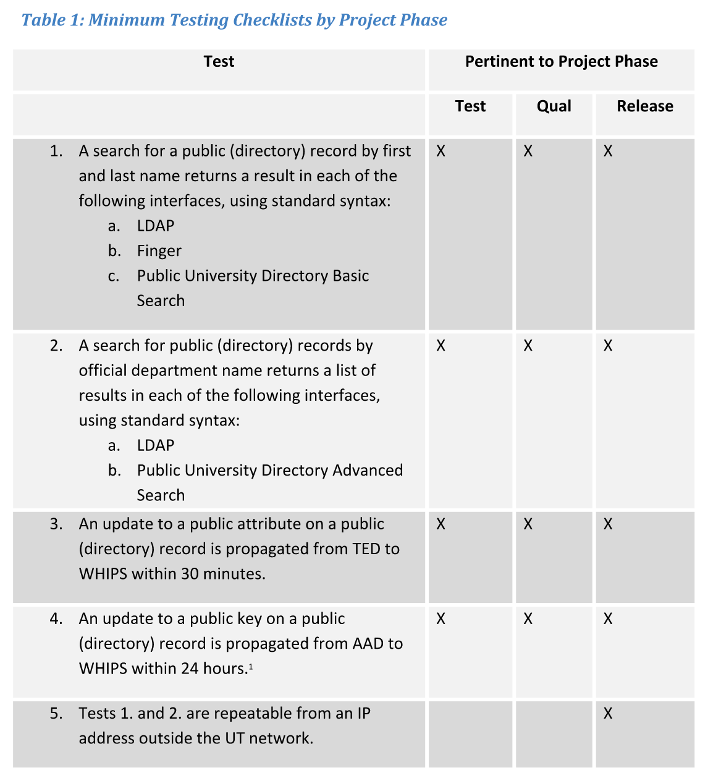
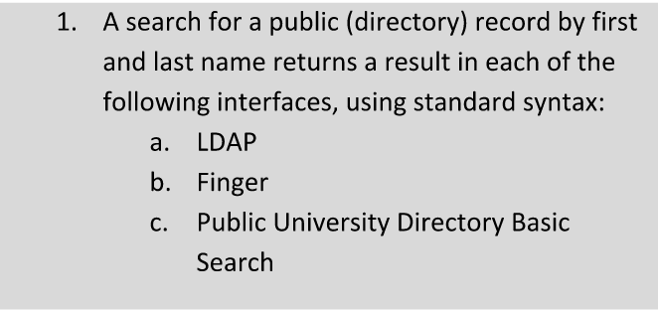



Slide 27
Example Prioritization Strategies
Most visited pages
Highest visibility functionality
Most business critical
Highest
Most fragile
Newest

Slide 28
Do More than the Minimum
The minimum testing checklist is great for deployment testing
The minimum testing checklist is great for emergencies
The minimum testing checklist is usually not enough for all stages of a project

Slide 29
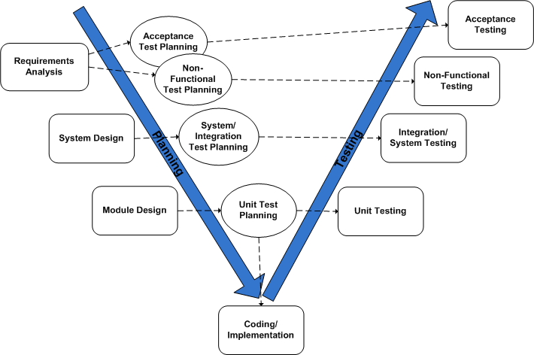

Slide 30
Make a plan.
Follow it until it needs updating.
Update your plan.

Slide 31
Be Strategic
Know what the team could be testing, then decide what you will test
Time box your testing
Acknowledge the learning curve

Slide 32
Common challenge: Confirm that something works.
You don’t know what “works” means

Slide 33
Be Agile
In each sprint, functionally test each story
At sprint end, perform regression testing
Manageable regression testing is usually minimum testing checklist+
Update your regression test list as the site evolves

Slide 34
WHO DOES THE TESTING?

Slide 35
Know Your Team
Use testing to see the big picture
Be fair
#1 trait of a good functional tester: EMPATHY

Slide 36
Don’t be the only one to test your own code

Slide 37
TEST AUTOMATION

Slide 38
Good Candidates for Automation
Regression tests (save time)
Functionality that is stable (minimize rework)
Functionality that can reset its own data (maximize reuse)

Slide 39
Test automation is not the solution.
It is a tool.

Slide 40
Testing Tools to Consider
Front end functional testing : Selenium
Site performance: SiteImprove
Accessibility testing: axe, WAVE
Visual testing: Ghost Inspector, Percy.io, Applitools

Slide 41
Automation Is Not Free
Tests get stale quickly
Test maintenance takes time
Investigating test failures takes time
Keep the automation short, sweet, and pertinent

Slide 42
THINK LIKE A TESTER

Slide 43
A tester’s job is to make the site (and team) look good.

Slide 44
Place empathy first in end-to-end testing. Put yourself in the user’s shoes.

Slide 45
Consider Personas
An experienced site user
A brand new visitor
A content author
A site administrator
A resident of another country

Slide 46
ALMOST DONE!

Slide 47
There is no “one size fits all” solution.
Think early and often about quality goals.
Allow time for testing – automation included.

Slide 48
THANK YOU, QUESTIONS?

Slide 49
PLEASE PROVIDE YOUR FEEDBACK!
http://mid.camp/6341

Slide 50
CONTRIBUTION DAY
Saturday 10am to 4pm
You don't have to know code to give back!
New Contributor training 10am to Noon with AmyJune Hineline of Kanopi Studios

